Slide 1

CLOUD BASED BUS PASS SYSTEM
Submitted by:
SAKSHAM JOHRI (171510046)
AAYUSHI RAI (171510003)
PRANJUL SINGHAL (171510040)
DEPARTMENT OF COMPUTER ENGINEERING AND APPLICATIONS
Institute Of Engineering and Technology
GLA University
Mathura-281406,INDIA
2019

Slide 2
CONTENTS
INTRODUCTION
WHAT IS CLOUD
LANGUAGES USED
CLOUD PLATFORM USED
LIST OF FIGURES
ADVANTAGES
DISADVANTAGES
SOME GLIMPSE OF PROJECT
CONCLUSION

Slide 3
INTRODUCTION
Customer can buy the bus ticket over the Internet, 24 hours a day, this solves the issue of ticket being misplaced or stolen.
This system is built up using cloud infrastructure for improved performance.
Using this website we can check all details related Bus pass.
This website keeps all information of all Bus passes.
Passengers first need to verify themselves through registration.
Users can recharge through cc debit cards

Slide 4
WHAT IS CLOUD
Cloud computing is the on-demand delivery of compute power, database and other IT resources via the internet with pay-as-you-go pricing.
A cloud services platform provides rapid access to flexible and low cost IT resources.
Cloud computing is a general term for anything that involves delivering hosted services over the Internet.
Example: Google Drive, Apple iCloud, Amazon Cloud Drive etc.

Slide 5
LANGUAGES USED
HTML
CSS
PHP
JAVA Script

Slide 6
CLOUD PLATFORM USED
Amazon web services
* Amazon web service is a platform that offers flexible, reliable, scalable, easy-to-use and cost-effective cloud computing solutions.
* The platform is developed with a combination of infrastructure as a service (IaaS), platform as a service (PaaS) and packaged software as a service (SaaS) offerings.

Slide 7
AWS Compute Service: Storage
EC2(Elastic Compute Cloud) - EC2 is a virtual machine in the cloud on which you have OS level control. You can run this cloud server whenever you want.
AWS Lambda — This AWS service allows you to run functions in the cloud. The tool is a big cost saver for you as you to pay only when your functions execute.
Amazon S3 or Amazon Simple Storage Service is a service offered by AWS that provides object storage through a web service interface. Amazon S3 uses the same scalable storage infrastructure that Amazon.com uses to run its global e-commerce network.

Slide 8
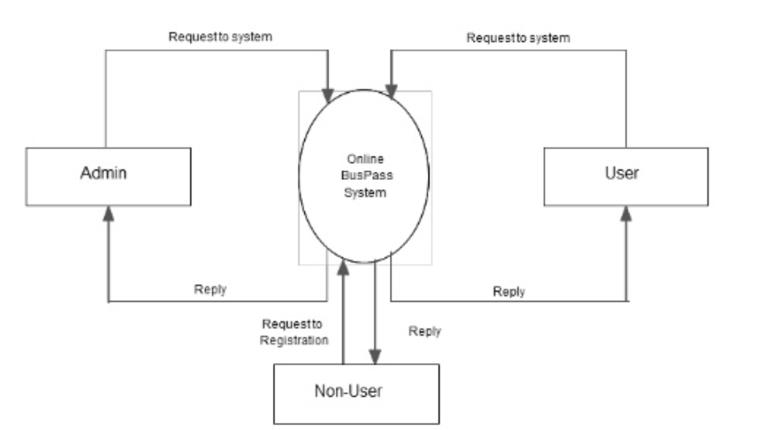
LIST OF FIGURES
Context Level DFD

Slide 9
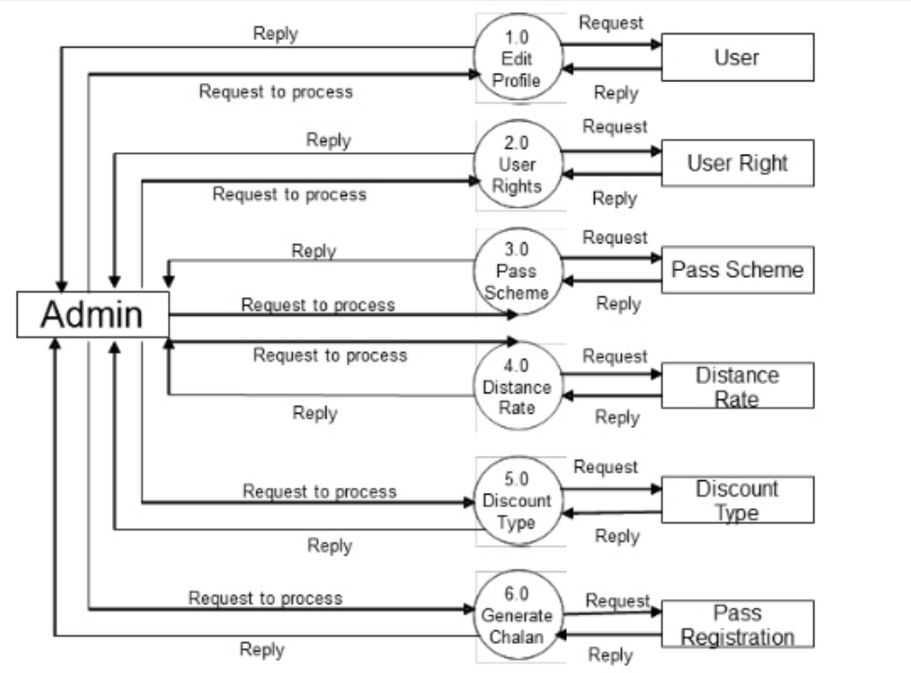
User Side: 1 level DFD

Slide 10
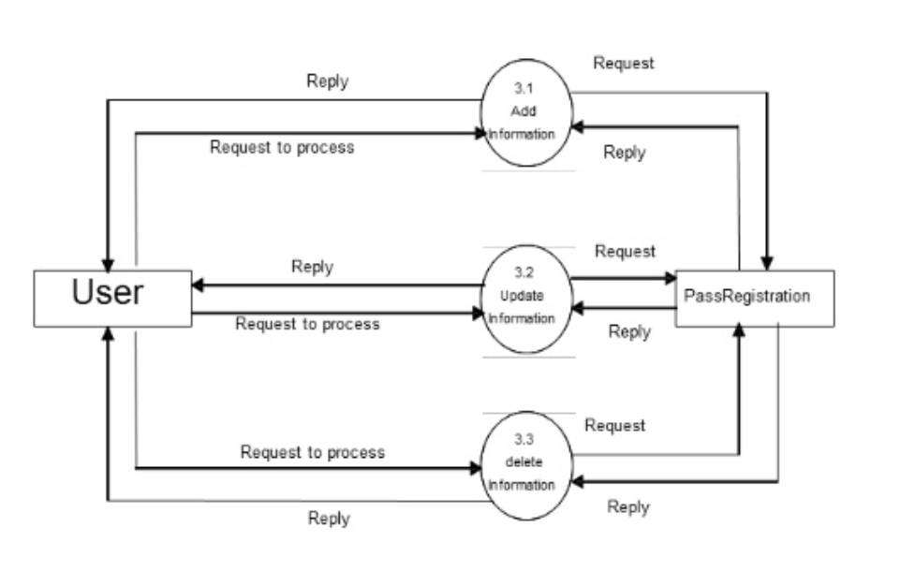
User side: 2 Level DFD

Slide 11
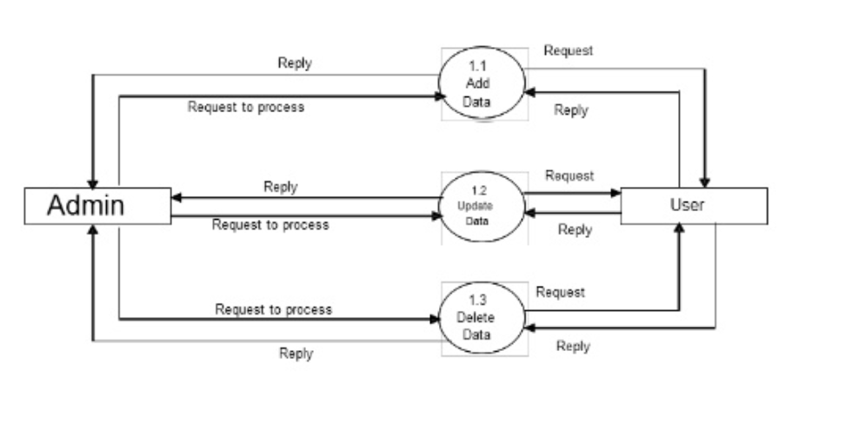
Admin Side

Slide 12
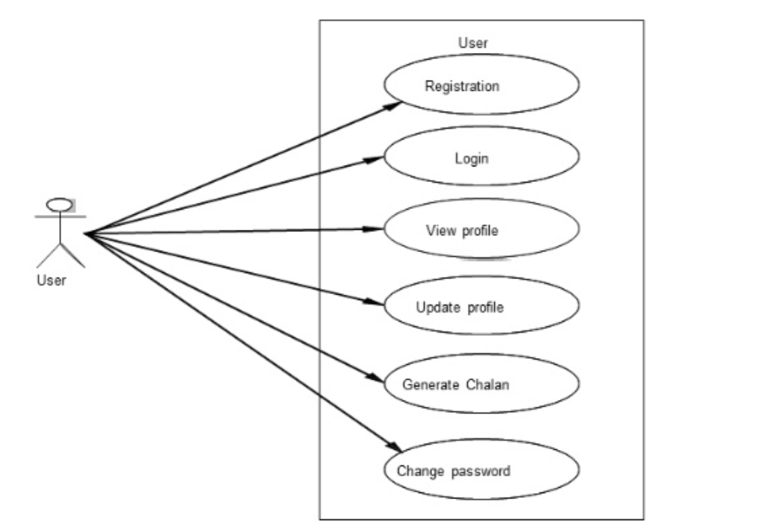
Use Case Diagram for User

Slide 13
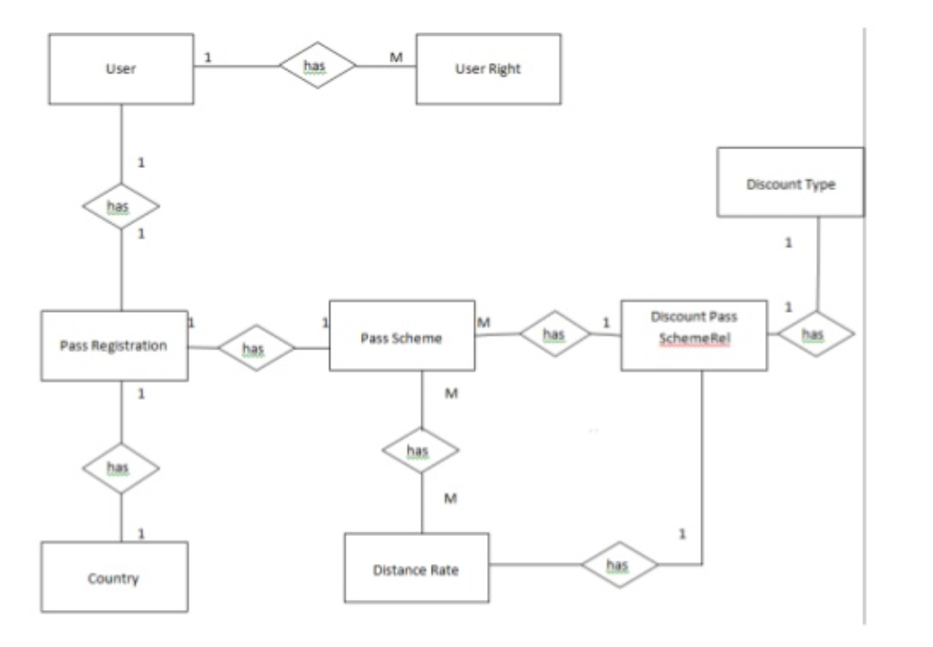
ER Diagram

Slide 14
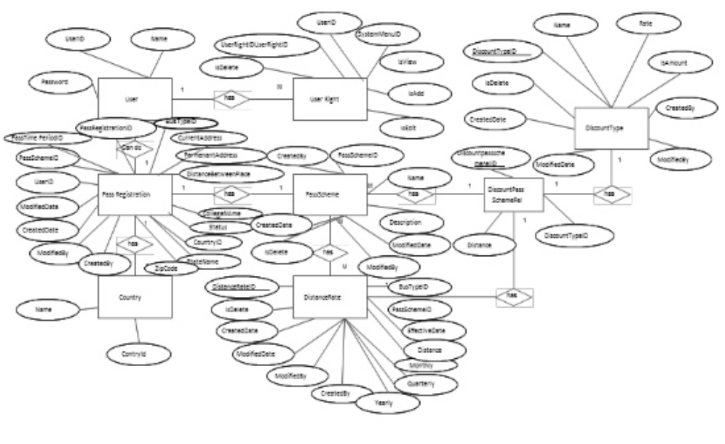
ER Diagram with Attribute

Slide 15
ADVANTAGES
Passengers don’t have to waiting time in queue.
Its mostly used for most of the employers.
Information is accurate.
It is a fast process.

Slide 16
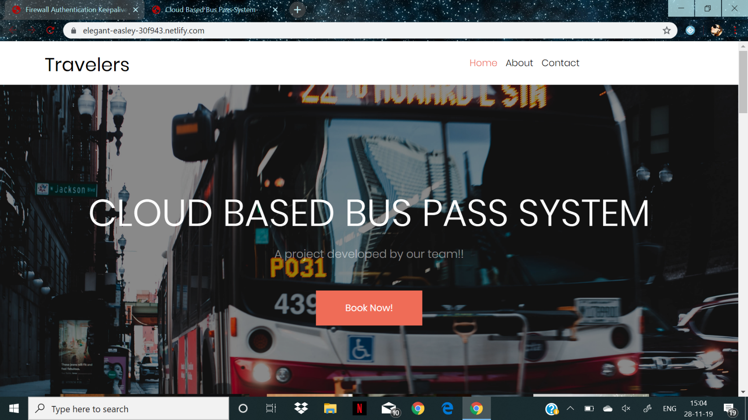
GLIMPSE OF PROJECT
Front Page

Slide 17
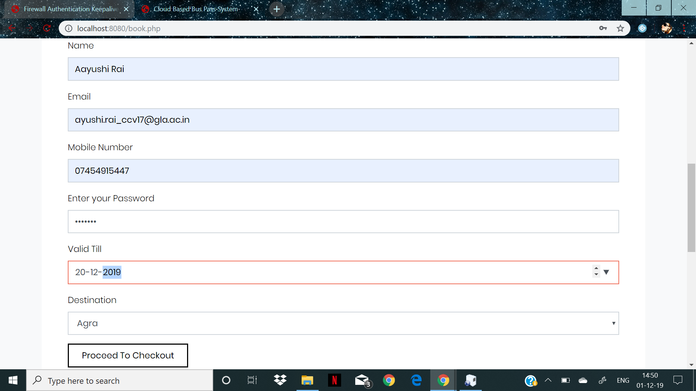
Registration Form

Slide 18
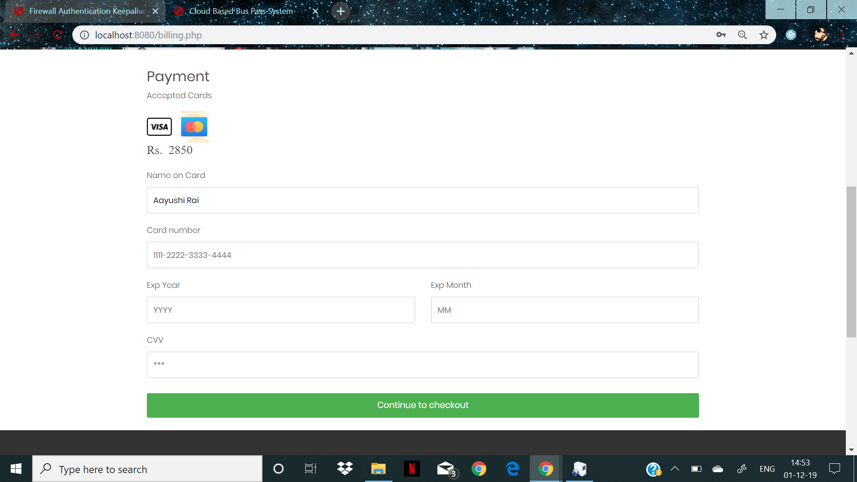
Payment Form

Slide 19
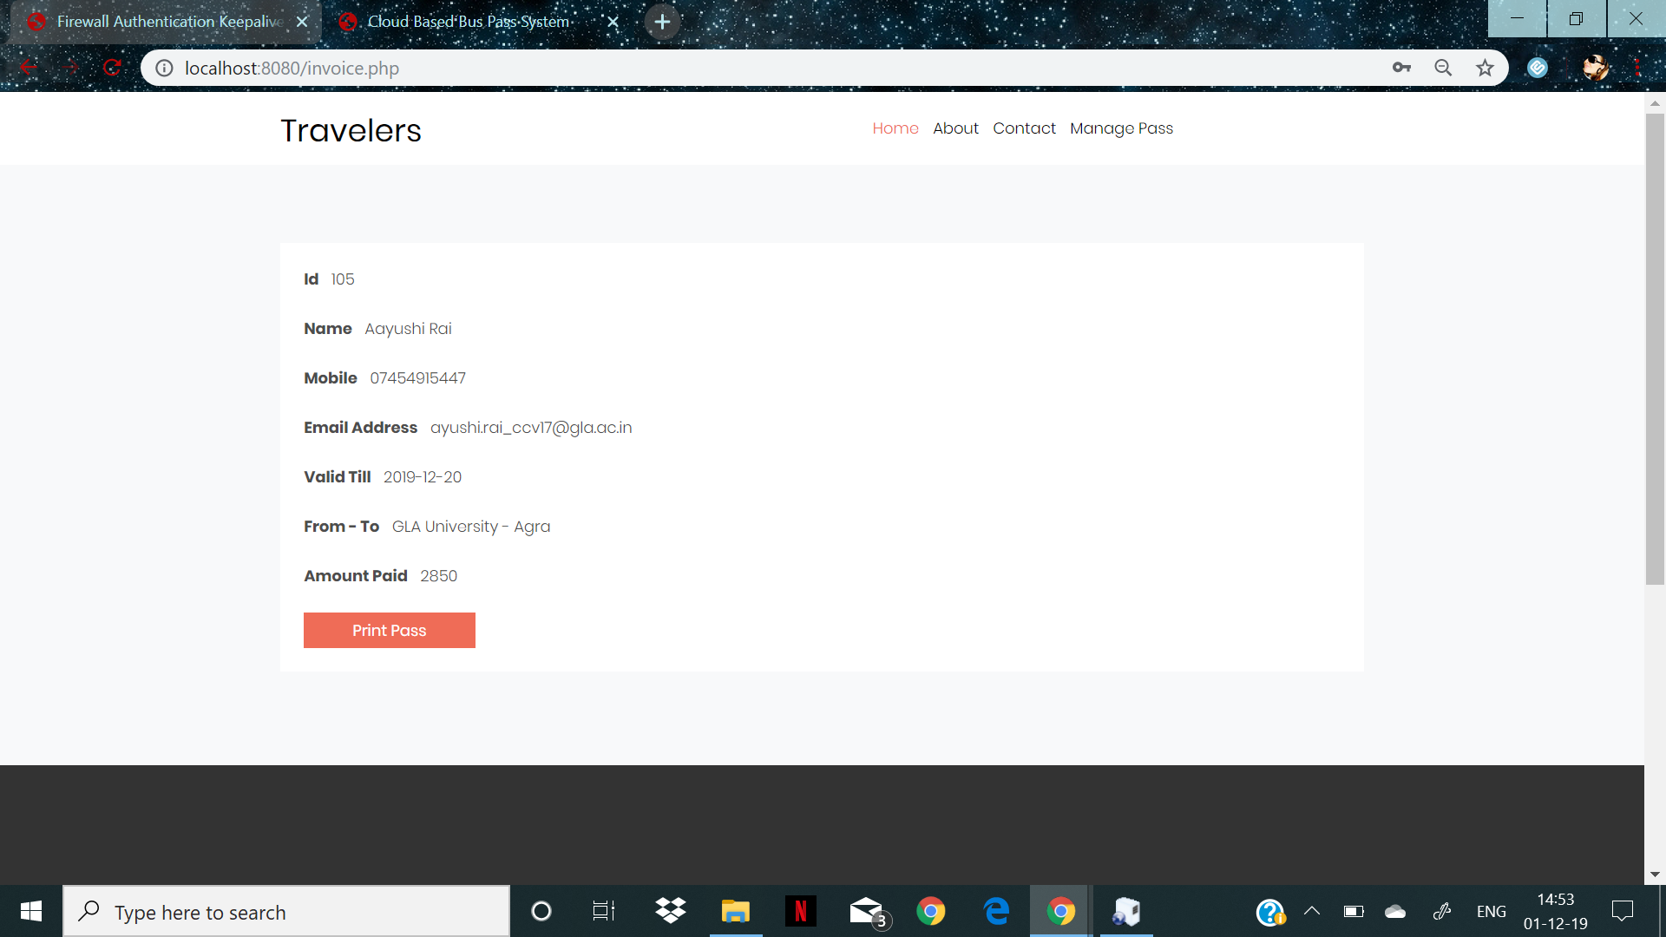
Printing The Pass

Slide 20
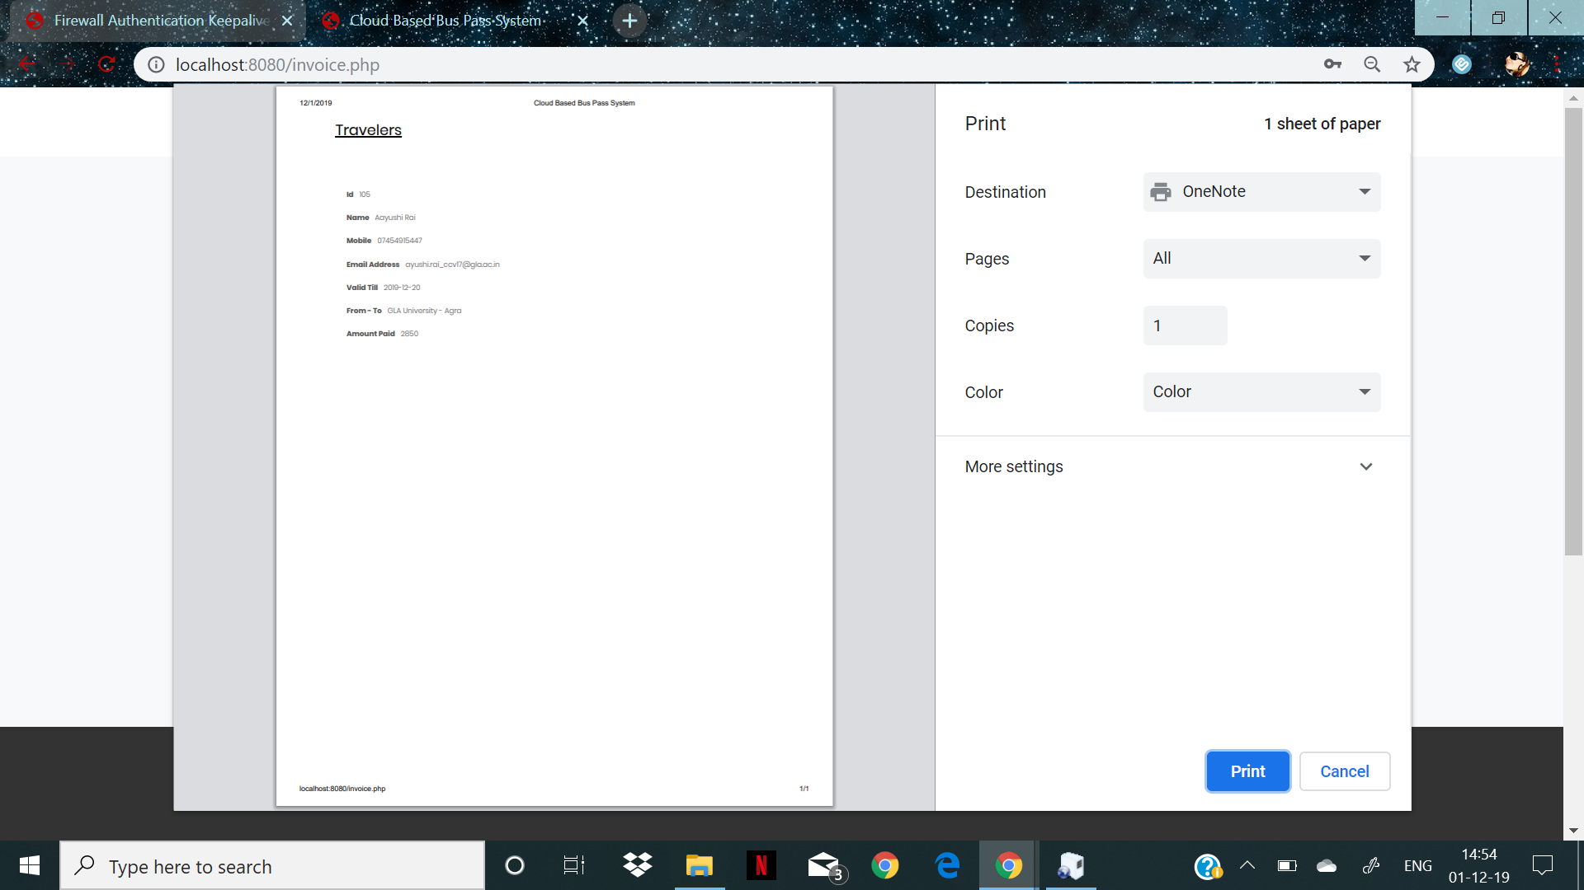

Slide 21
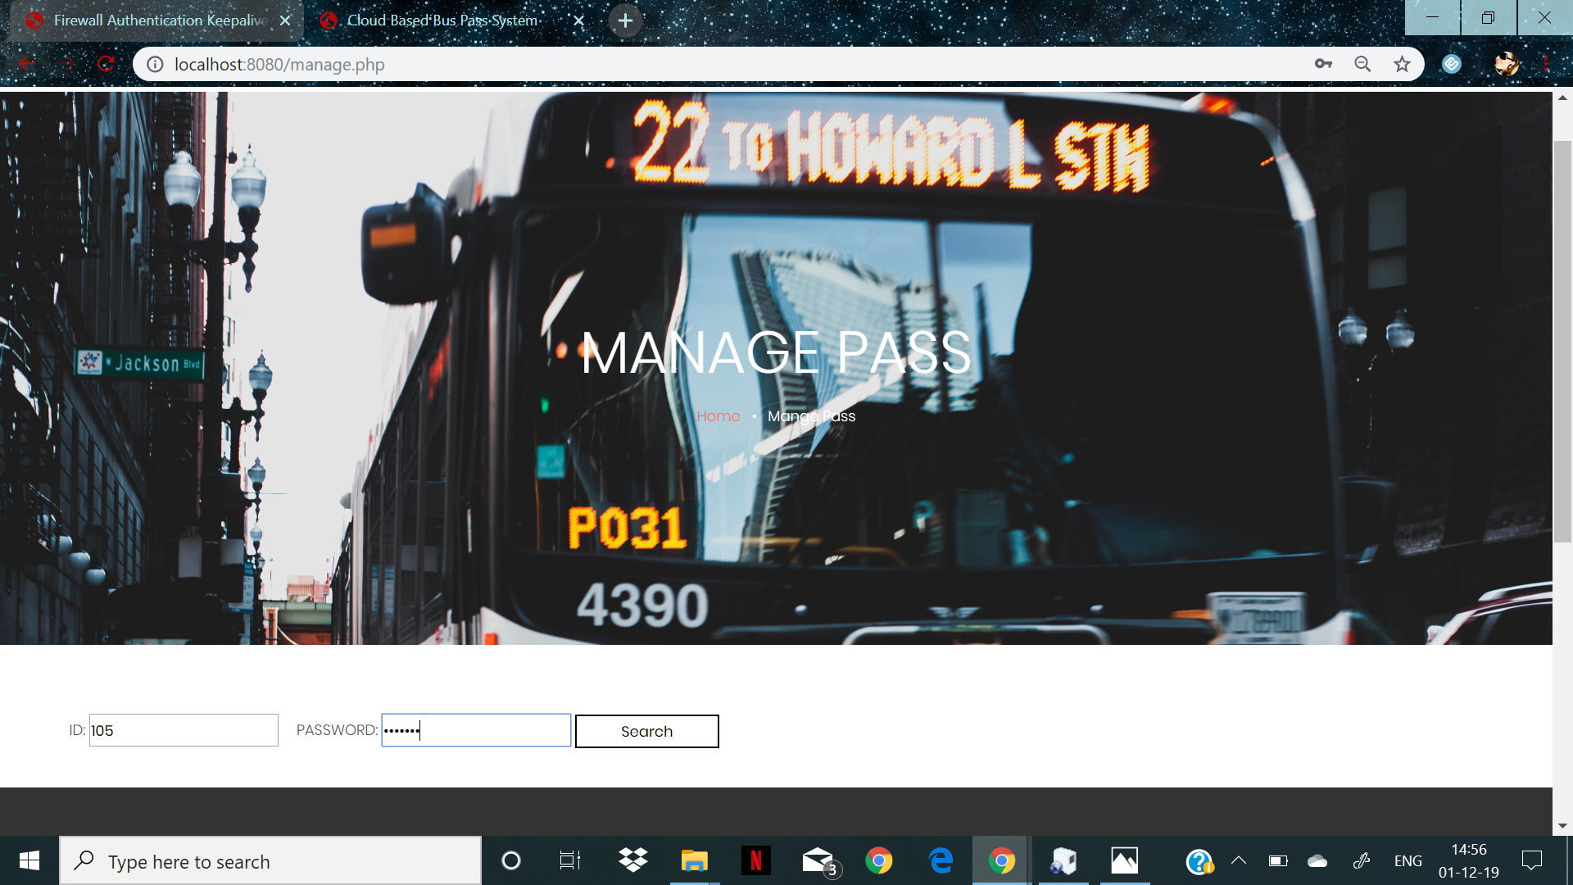
Managing the Pass

Slide 22
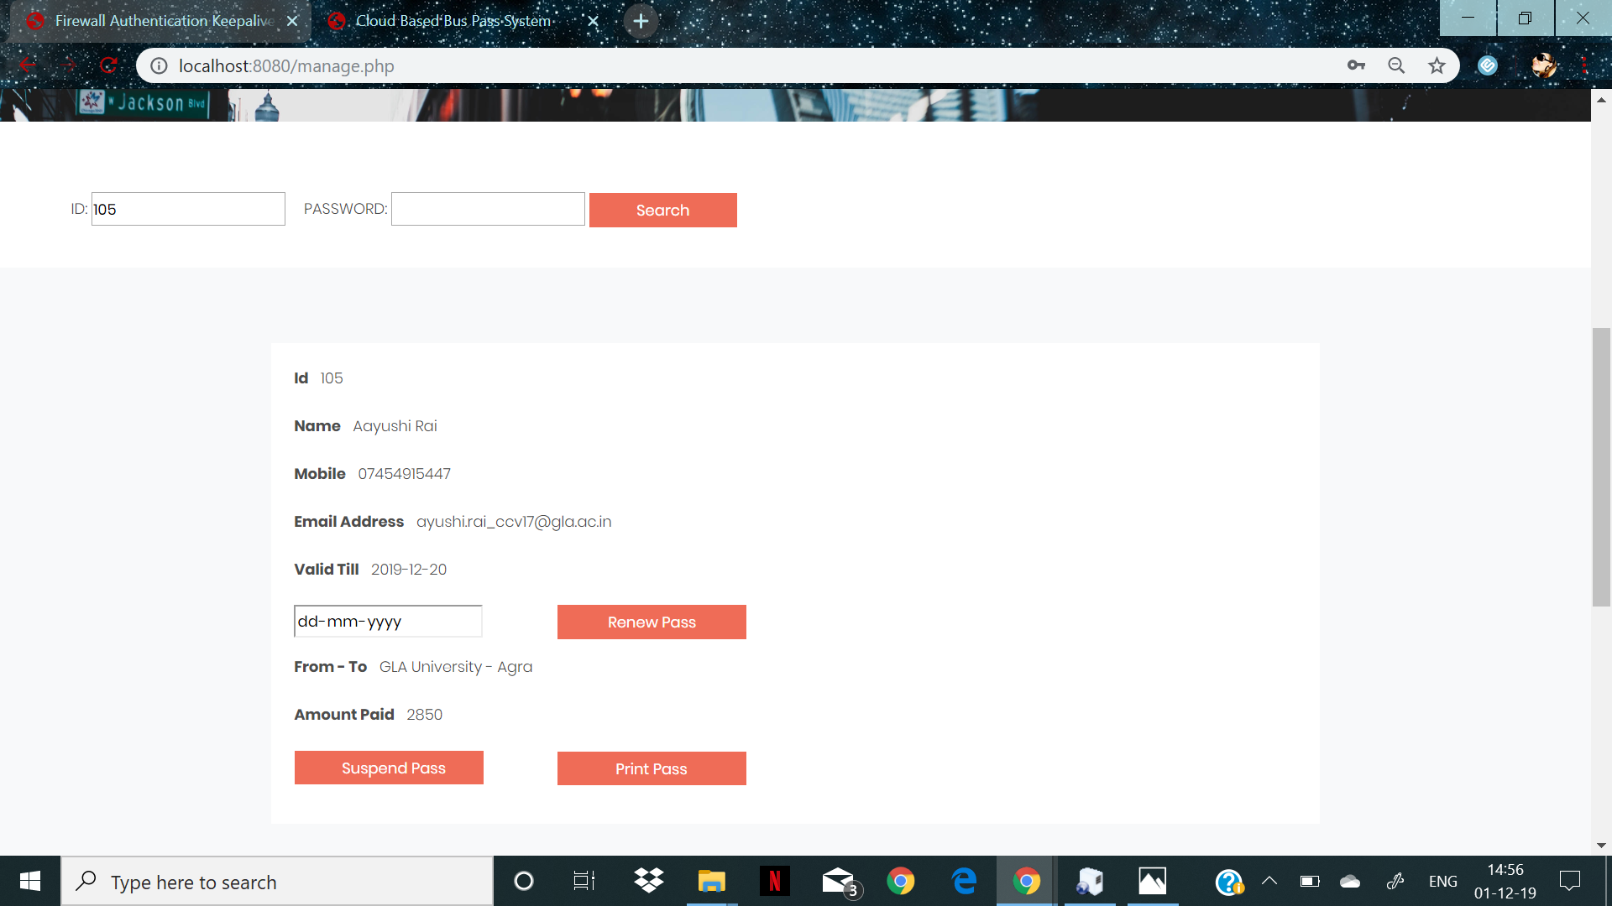

Slide 23
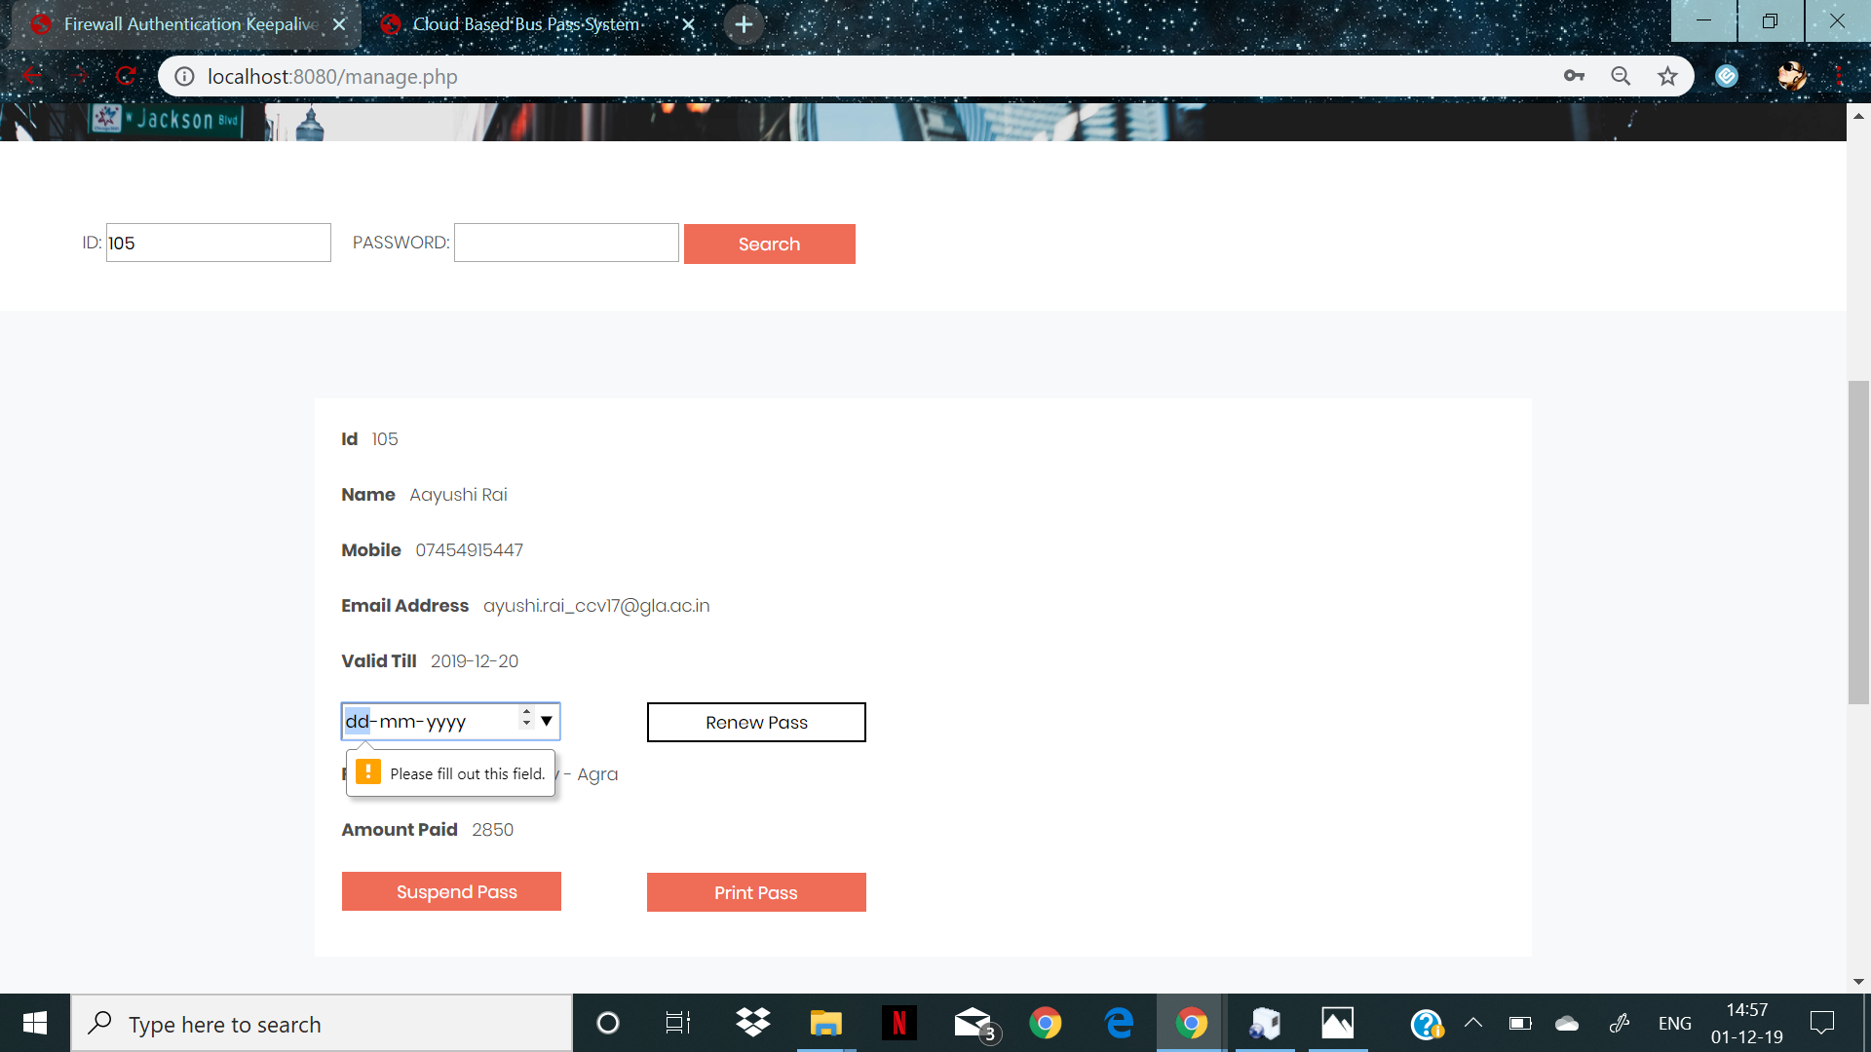

Slide 24
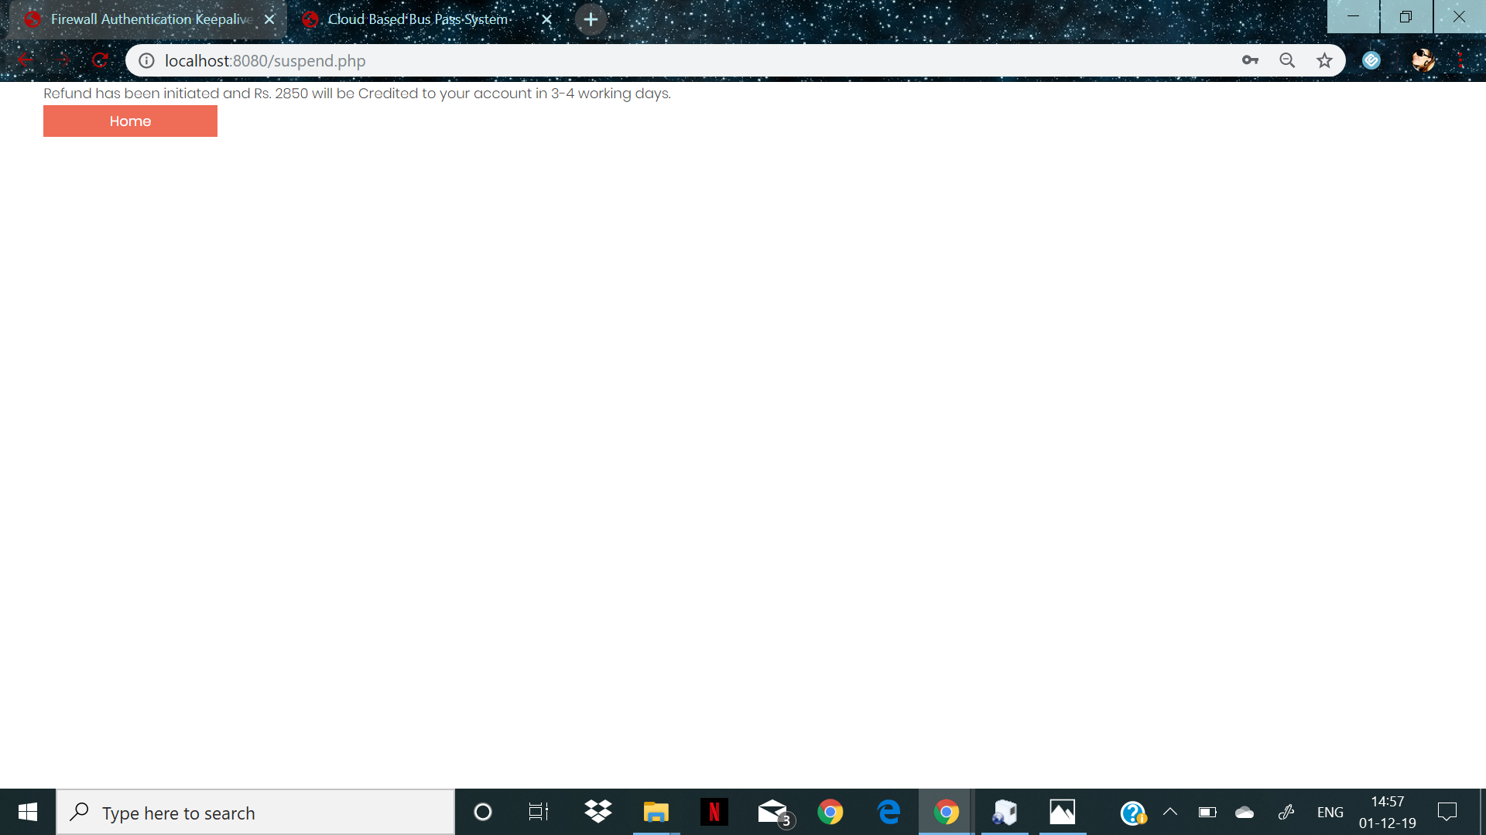

Slide 25
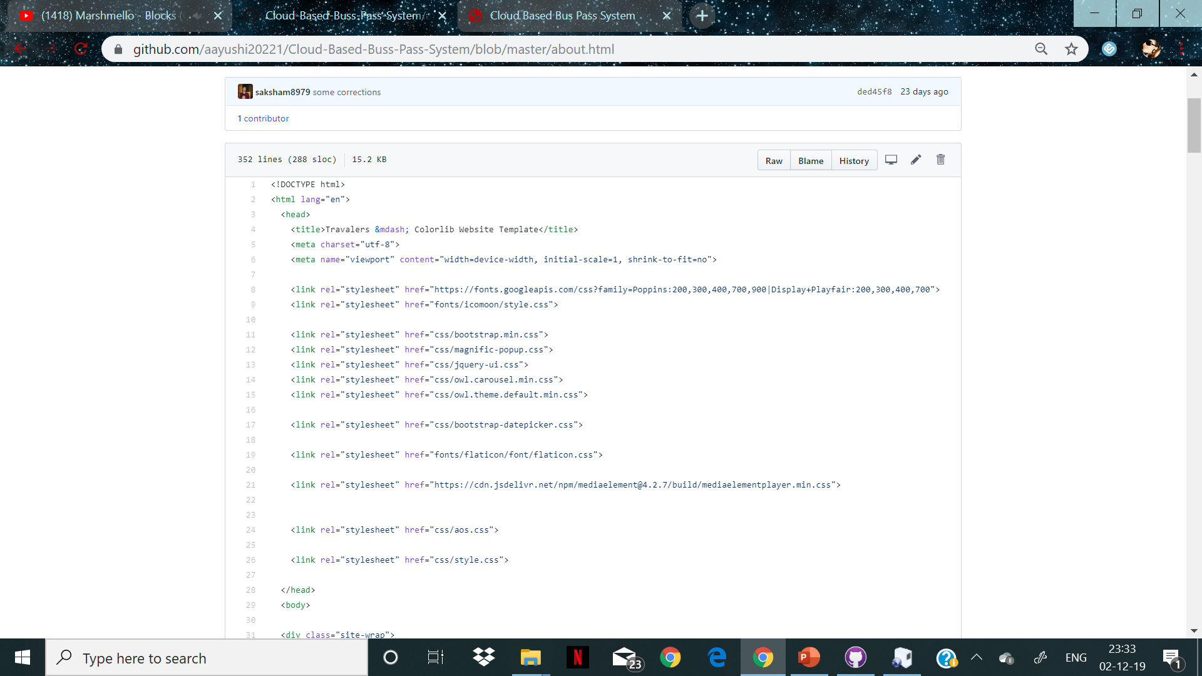
SOURCE CODE

Slide 26
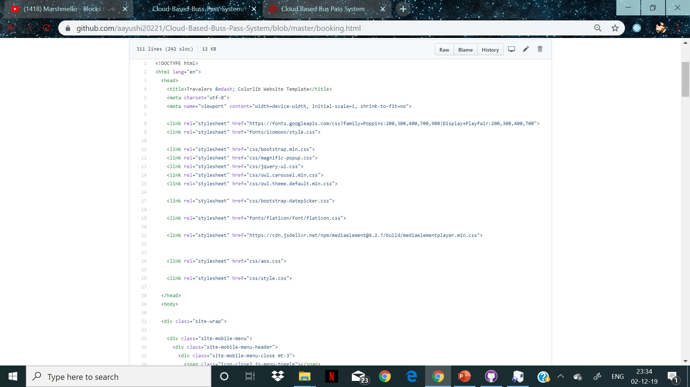

Slide 27
THANK YOU

